Slide 1




How to Formulate Specific How-To Questions
in Software Development?
Mingwei Liu¹, Xin Peng¹, Andrian Marcus², Christoph Treude³,
JiaZhan Xie¹, Huanjun Xu¹, Yanjun Yang¹
¹Fudan University , China
²The University of Texas at Dallas, USA
³The University of Melbourne, Australia
Notes:
Hi, every one. My name is Mingwei Liu. Currently, I conduct my post doctoral research in Fudan University. Today, I are glad to present our work: “How to Formulate Specific How-To Questions in Software Development?
”.

Slide 2

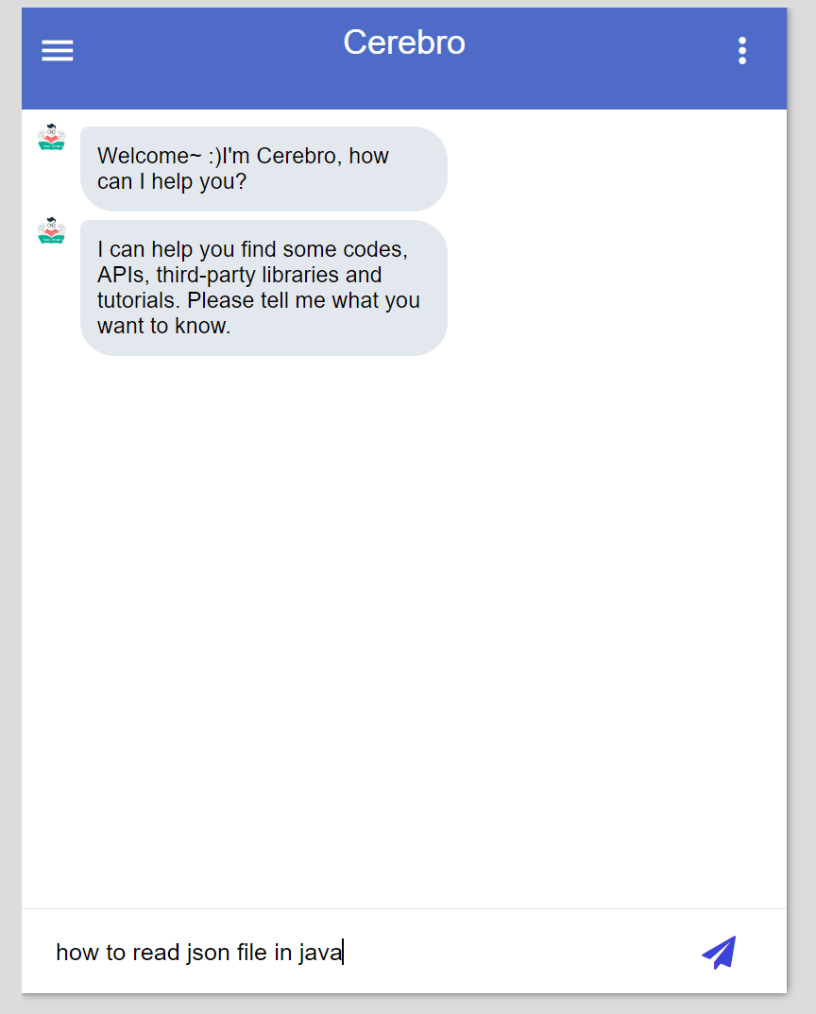

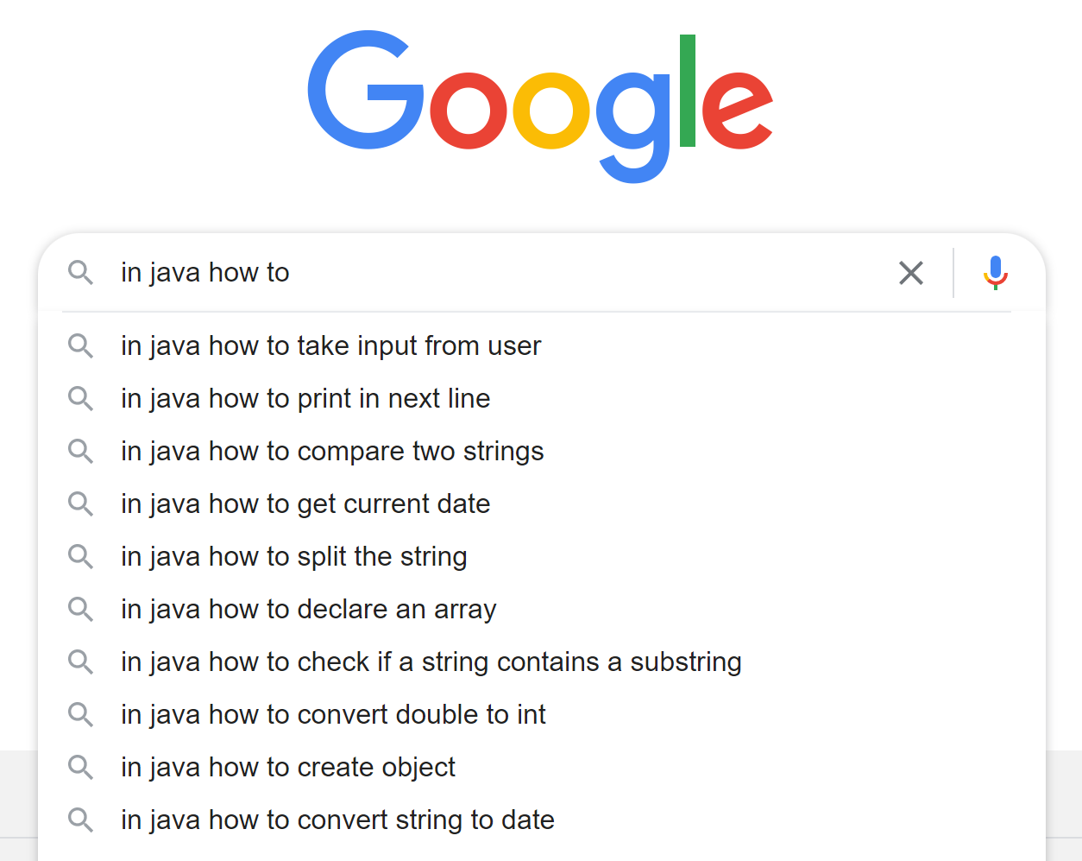


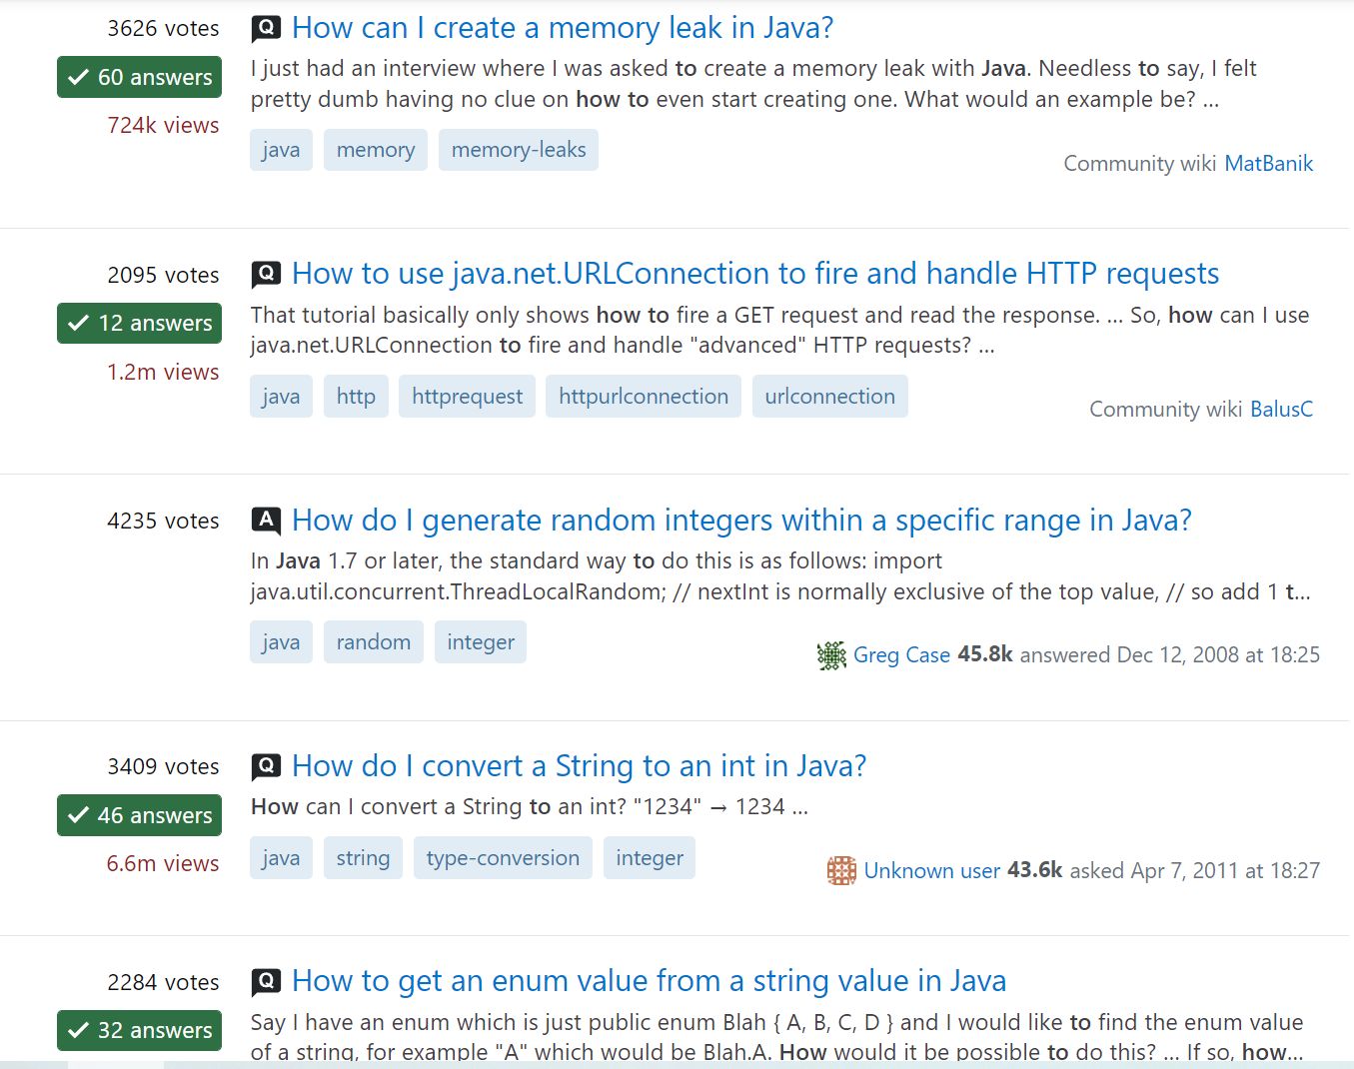

Background: How-to Question
Developers often ask how-to questions for instructions in software development
Search Engine
39%
A study shows that 39% of Stack Overflow questions are how-to questions [1].
Technical QA
Site
Interactive QA System
[1] Christoph Treude, Ohad Barzilay, and Margaret-Anne D. Storey. 2011. How do Programmers Ask and Answer Questions on the Web?. In 33rd International
Conference on Software Engineering, ICSE 2011, May 21-28, 2011, Waikiki, Honolulu,HI, USA. ACM, 804–807.
Notes:
In this paper, we focus on one specific type of questions, that is how-to questions. Developers often ask how-to questions for instructions in software development, for example “How to read json in java”. They will ask how-to questions using different tools, seeking help for their programming tasks. For example, they may ask how-to questions using search engines like google, or interactive Q&A systems,or technical Q&A sites like Stack Overflow . A study has shown that 39% of Stack Overflow questions are how-to questions.

Slide 3



Motivation
The objects are not specific enough
How-to questions usually describe the essential elements of the corresponding programming tasks：Action、Object、Constraint
The constraint is missing
How to read json in java
How to read a json file
How to read a file in java
How to read a json file in java
The essential task elements in the question need to be completely and precisely expressed.
Notes:
Based on our observation, how-to questions usually describe the essential elements of the corresponding programming tasks：that is Action、Object、Constraint. For example, for the two howto question, read is the action, json and json file are objects, and in java is the constraint, which are marked with different colors. For a how-to question, the key to whether it can be understood and answered correctly by a human or automated approaches is whether the question is specific enough, i.e., the essential task elements in the question are completely and precisely expressed.
For example, for the sample programming task, one may express it as “how to read a json file”, the other one may describe it as how to read a json file in java. Obviously, the green how to question is better than the red one because the red how-to question miss the constraints about the programming language. Other developer may answer the question incorrectly by providing the solution in python. As another example, other developers may express the same task as how to read json in java or how to read a file in java, which are not good as well. Because the objects json or file are not specific enough. Other developers may misunderstand they as json array or text file.

Slide 4
Empirical Study
12%
71%
Developers make frequent changes to SO task-related
questions, suggesting that they are often incomplete or unclear.
There are a total of
2,554,062 edit records for SO question titles and about 12% of the questions with title edits are how-to questions.
In a sample of 410 how-to questions with title edits, we found that task elements were involved in 71% of edits.
Formulating how-to questions is not an easy task
Notes:
In fact, formulating how-to questions is not an easy task. For example, there are more than two million edit records for SO question titles and about 12% of the questions with title edits are how-to questions. We further conduct an empirical study on 410 how-to questions with title edits, we found that task elements were involved in 71% of the edits. Developers make frequent changes to SO task-related questions, suggesting that they are often incomplete or unclear. Developers may struggle to describe the task elements well enough the first time. We could provide some tools to help them formulate how-to questions.

Slide 5

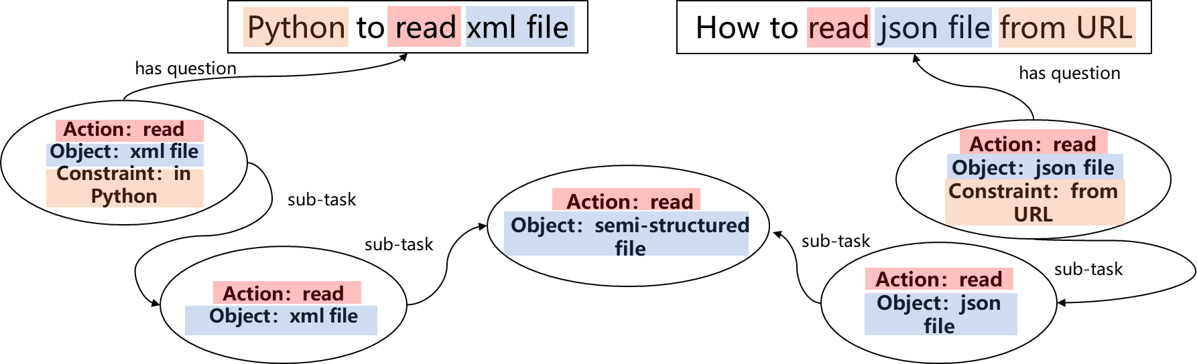

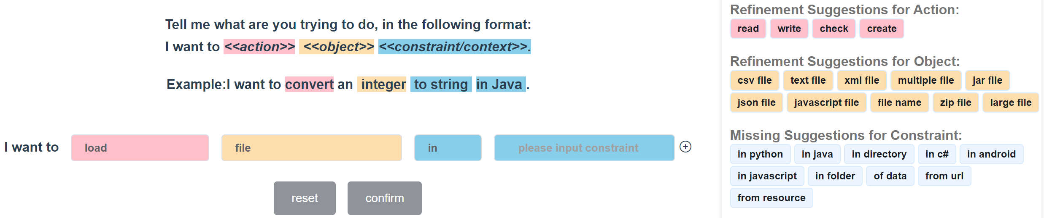
Idea
The structure and content of these past questions can help formulate new ones
Task Knowledge Graph
TaskKG4Q
Notes:
Our premise is that new how-to questions asked by developers are similar to existing task-related questions, hence the structure and content of these past questions can help formulate new ones. Based on this idea, we propose an interactive approach and tool (TaskKG4Q) that can help developers formulate specific how-to questions. TaskKG4Q uses a programming task knowledge graph constructed from SO question titles. The task KG provides a hierarchical conceptual structure for tasks in terms of [actions], [objects], and [constraints]. Based on the task KG, TaskKG4Q recommends appropriate and specific [actions], [objects] and [constraints] to developers, when they formulate how-to questions, and also suggests details that may be missing.

Slide 6
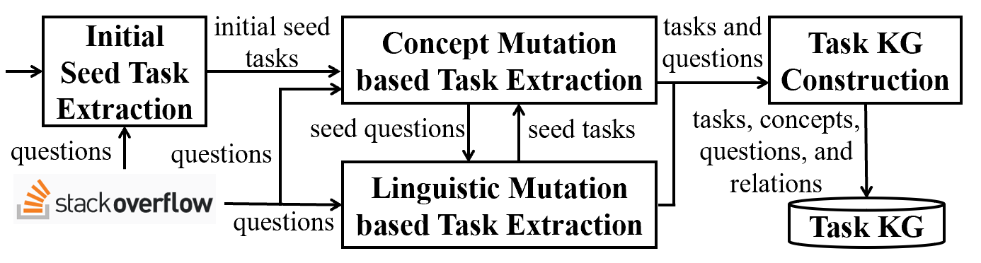
Task KG Mining Approach
An incremental and iterative approach that mines a task KG
from SO questions, by combining top-down and bottom-up
task extension strategies
Notes:
This slide shows the overview of our task KG construction approach. It is an incremental and iterative approach that mines a task KG from SO questions, by combining top-down and bottom-up task extension strategies. First, it extracts a set of seed tasks from SO questions by matching three predifined patterns; Then it incrementally and iteratively discovers additional tasks, through two task extension strategies to construct the task KG. The resulting task KG, includes tasks with new concepts and corresponding questions with new linguistic patterns, beyond those provided initially. Also, the task KG can evolve automatically, as more data becomes available.

Slide 7
Running Example
Concept Mutation based Task Extraction
(Top-down: Task->Question)
Concept-based Task Mutation
T1:Task(read, pdf file, in java)
T2:Task(read, xml file, in java)
…
T6:Task(read, pdf file, in python)
T7:Task(read, xml, in java)
…
T1:Task(read, pdf file, in java)
T2:Task(read, xml file, in java)
(Iteration 1)
Task Based Matching
Q1: Python to read pdf files
Q2: best way to read xml in java
Q3: how to read xml in java
…
T10:Task(read, structured binary file, with java)
(Iteration 2)
Seed Task Selection
discover annotated questions with new linguistic patterns
extract tasks with similar task elements
Task KG
Task KG Construction
Linguistic Pattern Mutation based Task Extraction
(Bottom-up: Question->Task)
Seed Question Selection
Task KG Construction
Q1: Python to read pdf files
Q2: best way to read xml in java
…
Q6: linq to read xml
Q7: best way to read structured binary files with java
…
Linguistic Pattern Based Matching
LP1: NP to read NP
LP2: best way to read NP ADP java
…
extract tasks described with a similar linguistic pattern
discover tasks with new concepts
Linguistic Pattern Generation
Notes:
To mine the task KG, we obtain a list of questions from SO as the corpus, for example, questions with popular tags, such as, “java”, “android”, “javascript”, and “python”. Next, we show how we perform a round of iteration on the corpus starting from two seeds T1 and T2. Task(read, pdf file, in java) and Task(read, xml file, in java). Different colors represent different task elements. First, we generate a number of possible tasks from the seed task by mutating task elements in the seed tasks based on some rules and external knowledge, such as general knowledge graph, SO tag systems. For example, python in the task could be replaced with Java to generate T6. because they are both programming languages.
Then, we will find the questions matching with seed task and mutation tasks.
Questions that refer to all task elements of one task at the same time are instance questions of the corresponding task and will be added to the task KG.
Then we select the questions of high confidence from the task KG as the seed questions of next step.
We annotate task elements in the seed questions and generalize some of them to wildcards.
In this way, we could obtain some linguistic patterns, such as LP2, where object XML becomes matched to any noun phrase. By matching linguistic patterns with questions, we can extract new questions Q6 and Q7 and new tasks from them, which will be added to our KG as well.
After that, we select new high quality seed tasks from the KG as the starting point for the next round iteration.
In fact, the iteration includes two parts (purple part and blue part), that is concept mutation based task extraction and linguistic pattern based task extraction. They complement each other.
The purple part is to and is to XX.
Further the purple part could and the other one could XX.
In this way, we incrementally to iteratively extract software development tasks and related questions to enrich our knowledge graph.

Slide 8
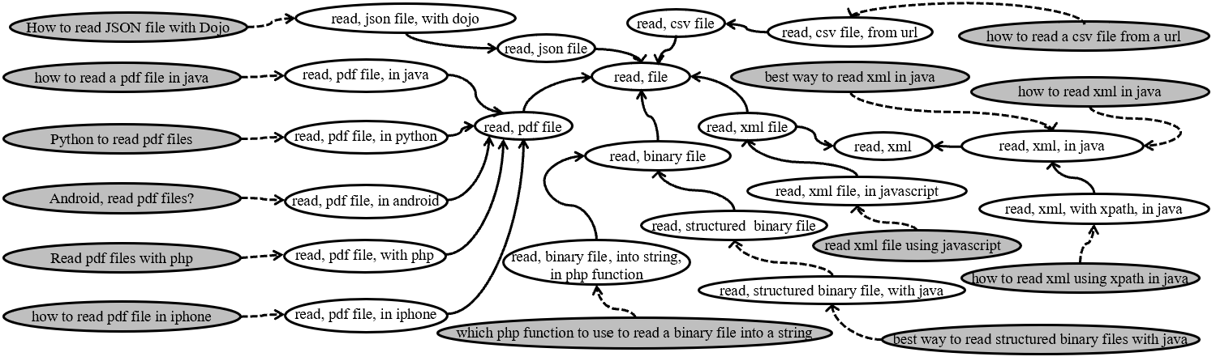


Task KG Example
“isA” relations between tasks
“instanceOf” relations between questions and tasks
SO Question
Task
Notes:
This figure shows part of the task KG describing tasks related to reading files. We construct the task KG to represent similar tasks to form a hierarchical knowledge structure, e.g., read a pdf file with different languages or on different platforms, or read different type of files.

Slide 9
TaskKG4Q User Interface
Based on the task KG, TaskKG4Q recommends appropriate and specific [actions], [objects] and [constraints] to developers, when they formulate how-to questions, and also suggests details that may be missing.
Notes:
Based on the task KG, we design an interactive tool TaskKG4Q to help developers write how-to questions This slide shows the user interface of our tool. The tool enforces the canonical format of <action, objects, and constraints> for the how-to question. The users can use the drop-down boxes to fill in task elements highlighted in different colors, click on the suggestions, or type freely. If the users need to write more than one constraint in the task, they can click the add button on the right to add more input boxes about constraints.

Slide 10

Research Question
RQ1: What is the intrinsic quality of the task KG?
RQ2: How effective is TaskKG4Q in helping developers formulate specific how-to questions?
RQ3: How useful is TaskKG4Q in helping developers complete programming tasks?
Notes:
We evaluate our approach by answer following research questions, which are about the intrinsic quality, effectiveness and usefulness.

Slide 11
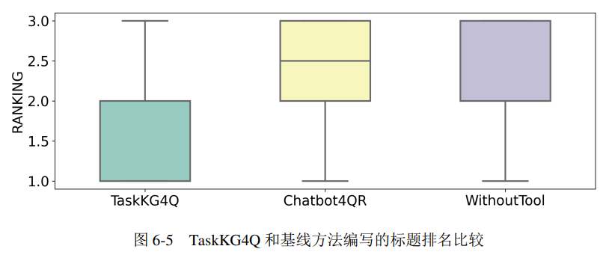
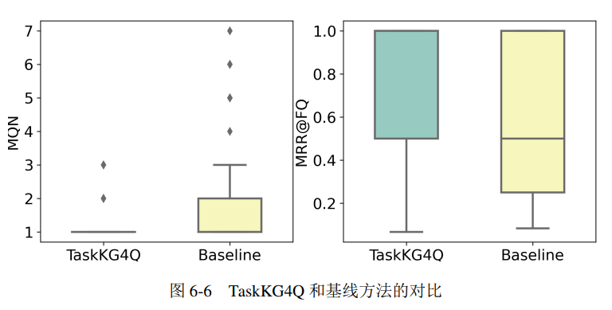
Evaluation Results
RQ2 TaskKG4Q Effectiveness
x
Design: We ask participants to formulate how-to questions for programming tasks and comparing with two baselines.
Result: TaskKG4Q helps developers formulate better how-to questions than Chatbot4QR or without tool support.
RQ1 Intrinsic Quality
Design: We randomly select 384 annotated questions with corresponding tasks from the task KG.
Result: 75.0% of sampled questions are correct.
RQ3 TaskKG4Q Usefulness
Design: We ask participants to complete a set of programming tasks. When they need to learn how to solve a specific task, we ask them to find the specifics on SO. They did that by writing questions on their own and with the TaskKG4Q tool. We then compared the questions written with or without the tool support and assess which ones are better.
Result: TaskKG4Q can help novices write better how-to questions for SO and they consider it easy to use.
Notes:
Next, we briefly describe the details of our experiments.
First, we construct our task KG from more than 200 thousand questions. In Rq1

Slide 12

THANKS
Postdoc at Software Engineering Lab,
Fudan University Any job opportunity is welcome!
Email: liumingwei@fudan.edu.cn
Homepage: https://mingwei-liu.github.io/

